Slide 1
Flagship Solution Scaling Tracks Inception Meeting and Process
Scaling Delivery Systems for Carp, Tilapia, and Small Indigenous Species (SIS) Genetics and Input Services in Bangladesh
January 19th, 2026

Slide 2
Description of the innovation
Scale a bundled decentralized aquaculture seed and service delivery system (SeedCompact)
Mobilizes licensed hatcheries, associated nurseries, and local service providers to deliver quality seed, advisory support, and monitored delivery at last mile.
How the package works (end-to-end delivery)
Quality seed + localized advisory services (including digital advisory via OneFish) → improved farm management → higher survival, productivity, and returns.
Builds on WorldFish and IFPRI experience (with DoF, BFRI, and academia) to adapt and apply practical SOPs and traceability –ready practices that strengthen quality assurance and seed system sustainability.
Evidence confirms effectiveness and scalability
Improved genetics example: G3 Rohu on-farm trials show clear gains in growth performance and farm profitability under farmer conditions.
Peer-reviewed evidence shows decentralized extension through private/local service providers improves adoption, production, income, and food security.
Responsible scaling
Use SOPs and traceability to link seed origin → service delivery → farmer outcomes, reducing quality risk and strengthening accountability as scale increases.
Track learning and equity outcomes through MELIA to improve delivery quality over time.

Slide 3
Scaling ambition
Scale decentralized aquaculture seed and service delivery in Bangladesh
Reach ~97,500 smallholder farmers by 2026 through SeedCompact-led delivery, working with licensed hatcheries and associated nurseries and local service providers.
By 2028, reach at least 300,000 farmers, while embedding practical quality assurance SOPs and traceability practices within delivery operations to strengthen quality assurance and seed system sustainability.
Targeted behavior change and system improvements
Improve farmer access to quality seed and advisory services, reducing uncertainty and production risk.
Provide capacity development and good-practice training for hatcheries and nurseries to improve consistency and reliability of seed supply.
What the S4I investment enables
Demonstrates that bundled delivery (seed + advisory + monitored delivery) can scale efficiently within Bangladesh’s aquaculture system.
Builds confidence among public and private actors to adopt decentralized delivery approaches based on operational evidence.
Key scaling challenges addressed
Quality variability and weak feedback loops across the seed system.
Limited ability to link seed source, service delivery, and farm outcomes.

Slide 4
Key demand partners
Demand partners
Department of Fisheries (DoF) Creates institutional “pull” for quality seed, inspection/extension, and uptake of quality assurance (QA) within national procedures.
Bangladesh Fisheries Research Institute (BFRI) Provides national technical legitimacy—sets broodstock, performance, and biosecurity standards and supports piloting with hatcheries.
.
PKSF + microfinance/NGO networks Aggregates demand from large pond-owning beneficiary networks; can connect beneficiaries to trusted hatchery–nursery supply and enable finance pilots
Private seed & input enterprises (e.g., EON dealer network) Market pull for consistent supply of improved tilapia and safe inputs; strengthens incentives for QA and trusted seed.
Cross-program / cross–Solution Track alignment SAAF provides the improved genetics pipeline; alignment with Agvisely climate advisories strengthens risk-informed decisions.

Slide 5
Key scaling partners
Scaling partners
Licensed hatcheries and SeedCompact nurseries/service providers: supply and deliver quality-assured improved seed with advisory and monitored delivery, ensuring genetic gains are realized at farm level.
PKSF-linked NGOs and partner organizations: Support farmer aggregation and access to working capital for service providers and producers, without substituting commercial seed production or delivery roles.
DoF and WorldFish delivery platforms (selected projects): Integrate SeedCompact approaches into ongoing programs, build frontline capacity, and link new beneficiaries to quality seed, advisory, and service systems.
Why working with these partners?
They already operate at scale within aquaculture seed and service markets, with established infrastructure, commercial incentives, and trusted relationships that allow delivery systems to expand efficiently without creating parallel structures.
How partners will be motivated
Access to improved genetics, targeted capacity building, and practical digital tools (e.g., OneFish), combined with facilitated working capital and demand aggregation through PKSF-linked partners, creates clear incentives to adopt good practices, reduce operational risk, and sustainably scale quality seed and advisory delivery.

Slide 6
Scaling Track Overview: Clarify the scaling pathway
Where scaling happens Bangladesh is the primary scaling context, with targeted South–South learning to Kenya based on Bangladesh’s more advanced aquaculture seed and service delivery system.
How the pathway reaches the last mile Decentralized delivery through SeedCompacts that link licensed hatcheries, nurseries, and local service providers into accountable networks delivering quality seed, advisory support, and monitored distribution.
Who supports and sustains the pathway WorldFish and DoF projects embed SeedCompact delivery within ongoing programs to expand reach, build frontline capacity, and generate operational evidence. PKSF-linked partners facilitate access to working capital tied to good practices.
What enables responsible scale Improved genetics (e.g., G3 rohu evidence), capacity development, and digital enablers (OneFish, aligned advisories) strengthen decision-making, quality assurance, and learning.
System alignment Alignment with SAAF (genetics development) and S4I-supported delivery and learning supports institutional uptake and long-term sustainability.

Slide 7
Scaling Pathway Rationale: Theory of Scaling and Action
Theory of change: Reliable access to improved aquaculture genetics, when delivered through decentralized and accountable service networks, reduces production risk for farmers, improves farm performance, and creates incentives for private actors to sustain quality seed and advisory delivery at scale.
Theory of action: S4I supports the organization of SeedCompact delivery networks, strengthens partner capacity on good practices and monitored delivery, and generates operational evidence that improves delivery quality and enables replication across programs.
Pathway rationale: The pathway builds on documented evidence and operational experience from Bangladesh’s aquaculture system, demonstrating that decentralized delivery can scale when quality and learning are integrated.

Slide 8
Scaling Track Overview: Specify S4I Investments
What S4I invests in (2026 focus) S4I provides catalytic investments to organize, test, and strengthen decentralized aquaculture seed and service delivery so it can be sustained by private and public actors.
Key S4I-funded activities include:
Partnership formation and contracting with licensed hatcheries, nurseries/local service providers, and digital partners supporting OneFish.
Integrated capacity development on good practices, advisory integration, and basic digital readiness.
Multi-stakeholder consultations with DoF, BFRI, and partners to align on practical certification SOPs, traceability principles, and governance roles.
Design and piloting of traceability tools embedded within SeedCompact delivery operations.
Performance monitoring to track delivery quality, seed performance, and service effectiveness for adaptive management.
Knowledge synthesis and learning events to support institutional uptake and cross-country adaptation.

Slide 9
Bilateral Projects, Cross-Program and Cross-Country Alignment
S4I additionality Scaling is primarily driven by private-sector and public delivery systems. S4I adds value by accelerating coordination, reducing early risks, and generating shared operational evidence that bilateral projects alone do not produce.
Bilateral and government alignment This pathway builds on prior WorldFish bilateral investments, including the Gates Foundation–supported Aquaculture Project and the CGIAR AMD initiative, which tested decentralized service delivery at pilot scale.
It aligns now with ongoing WorldFish projects (including WCS-supported initiatives) and planned bilateral programs (e.g., forthcoming GIZ-funded work).
Government engagement is anchored through Department of Fisheries–led programs, including the Expansion of Aquaculture Technology Services at Union Level (Phase III), where there is scope to jointly address key challenges in decentralized delivery to inform future institutional uptake.
Cross-program and cross-country learning S4I links SAAF (genetics development) with system-scale delivery and learning, and enables structured exchange under AoW3, including adaptation of Bangladesh experience to Kenya initiatives (e.g., CASA).

Slide 10
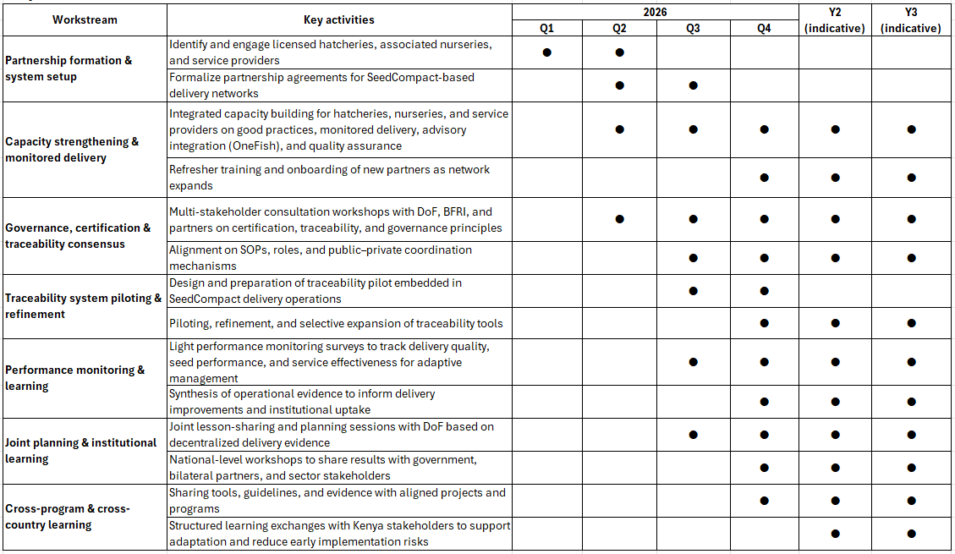
Implementation Gantt Chart

Slide 11
PRMS evidence and reference materials
PRMS linkages
Other evidence and reference materials
Ali, H., Murshed-e-Jahan, K., Biswas, A., Hamilton, M.G., 2025. Growth Performance and Profitability of Genetically Improved and Commercial Local Rohu (Labeo rohita) in Bangladesh. Aquaculture Research. 9986779, 22. https://doi.org/10.1155/are/9986779
Hamilton, M.G., Yeasin, M., Alam, M.B., Ali, M.R., Fakhruddin, M., Islam, M.M., Barman, B.K., Shikuku, K.M., Shelley, C.C., Rossignoli, C.M., Benzie, J.A.H., 2022. On-Farm Performance of Genetically Improved Rohu (Labeo rohita) in Bangladesh. Frontiers in Aquaculture 1, 1060335. https://doi.org/10.3389/faquc.2022.1060335
Obi, C., Manyise, T., Dompreh, E.B., Murshede-Jahan, K., Rossignoli, C.M., 2025. The impact of extension delivery through private local service providers on production outcomes of small-scale aquaculture farmers in Bangladesh. The Journal of Agricultural Education and Extension, 31 (2), 215-233. https://doi.org/10.1080/1389224X.2024.2371292
Dompreh, E.B., Manyise, T., Lozano Lazo, D., Murshed-e-Jahan, K., Lam, R.D., Rossignoli, C.M., 2024. Exploring the potential of decentralized extension models on the sustainability of livelihoods: a food security lens on aquaculture farmers in Bangladesh. Frontier in Sustainable Food System, 8, 1499081. https://doi.org/10.3389/faquc.2022.1060335
Yeasin, M., Hamilton, M.G., Ali, H., Murshed-e-Jahan, K., Islam, A.F., 2025. Carp Genetic Improvement and Dissemination: Progress and Future Pathways. Workshop report. WorldFish, Dhaka, Bangladesh.
Innovation Profile :​
Bangladesh:​
https://reporting.cgiar.org/reports/result-details/5335?phase=6​
https://reporting.cgiar.org/reports/result-details/5346?phase=6​
https://reporting.cgiar.org/reports/result-details/5368?phase=6​
https://reporting.cgiar.org/reports/result-details/18181?phase=6
Notes:
* PRMS = CGIAR’s Performance and Results Management System where CGIAR tracks innovation development and innovation use (scaling) progress. Visit: www.reporting.cgiar.org or https://www.cgiar.org/food-security-impact/new-results-dashboard/

